Slide 1
March 2022 Issue # 32

Slide 2
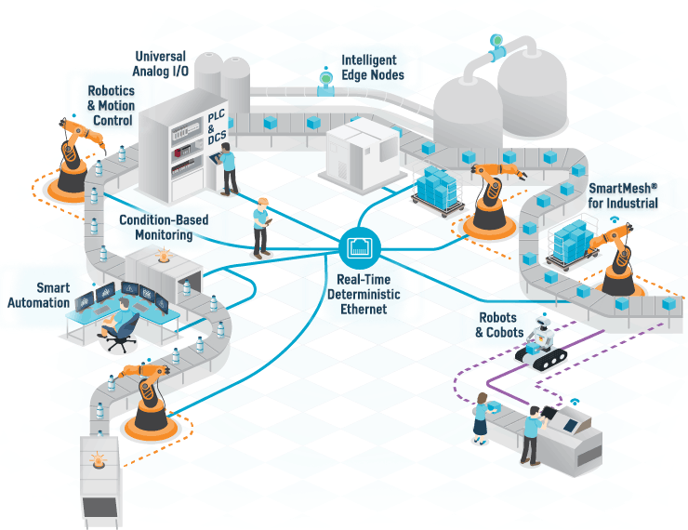
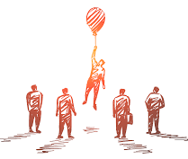
CONTENTS
AWARDS, APPRECIATIONS & FELICITATIONS
TECHNICAL BLOGS
SPECIAL PROJECTS, EVENTS & AUDITS
KNOWLEDGE SHARING
EMPLOYEE ENGAGEMENT, CSR & MOTIVATION STORY

Slide 3
AWARDS, APPRECIATIONS & FELICITATIONS
CONGRATULATIONS TO ALL MEMBERS !!!
We feel proud to share that Rucha Yantra’s LinkedIn family is also growing and has surpassed 9000+ followers last month. We cannot thank you enough for engaging on our updates on LinkedIn and helping our company grow on LinkedIn. With your support we sure will reach greater heights.
CONGRATULATIONS TO ALL MEMBERS !!!
We feel very proud to share that Rucha Yantra’s LinkedIn family is also growing and has surpassed 7000+ followers last month. We cannot thank you enough for engaging on our updates on LinkedIn and helping our company grow on LinkedIn. With your support we sure will reach greater heights.

Slide 4
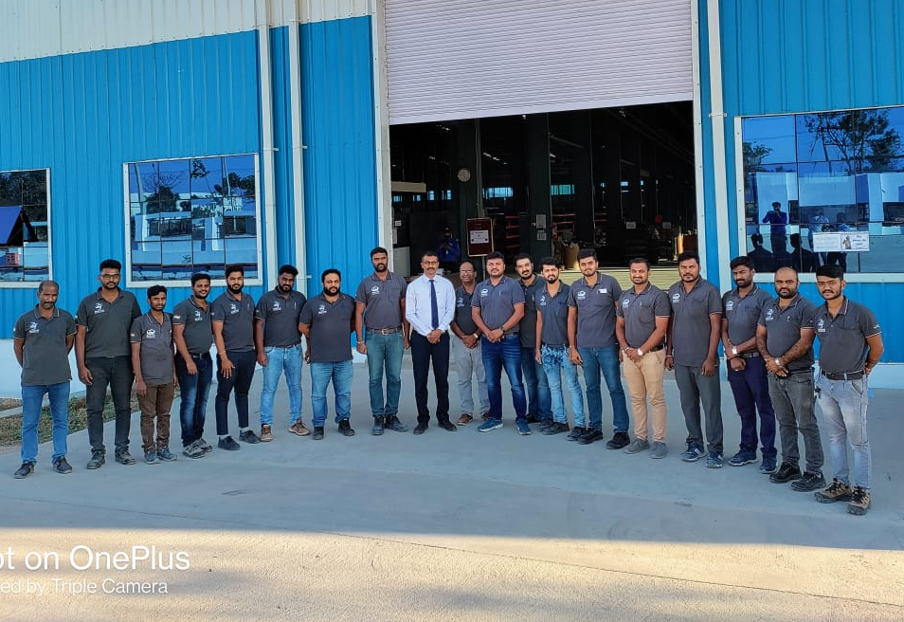
AWARDS, APPRECIATIONS & FELICITATIONS
PLANT X CERTIFIED FOR IATF 16949 : 2016
IATF 16949 : 2916 Stage 2 Audit has been carried out By Mr. V Ravi from The British Standards Institution i.e. BSI at REPL Plant X and the same is cleared though common team efforts. As we have successfully cleared the Audit & Plant X is recommended For IATF certifications too.
Congratulations to each and every members who contributed of this Audit!
HEARTIEST CONGRATULATIONS PLANT V TEAM
ISO 14001:2015 and ISO 45001:2018 certification Stage 1 Audit has been carried out By Mr Sunil Wankhade From The British Standards Institution i.e. BSI on 28th and 29th March 2022 at Plant and the same is cleared through common team efforts.
We have successfully cleared this Audit and recommended For Final certification.

Slide 5
TECHNICAL BLOGS
A LEAP INTO THE FUTURE WITH METAVERSE
From being a mere fantasy to a feasible business proposition, the world of Metaverse has traveled a long way. In the last piece, we learned about the fundamental nature of the Metaverse, the technologies that make it possible, and how we can access it currently. Now, let’s focus more on its impact and how soon to expect it.
Billionaire and Facebook founder Mark Zuckerberg recently drew up a vision and simultaneously teased us with the immense possibilities of the new medium that promises to radically alter the way we live, conduct business, socialize, work and attend to a hundred different everyday affairs of our daily lives.
In a letter to his employees, Zuckerberg wrote, “We’ve gone from desktop to web to mobile; from text to photos to video. But this isn’t the end of the line. The next platform will be even more immersive and an embodied internet where you’re in the experience, not just looking at it. We call this the Metaverse, and it will touch every product we build.” So, without further ado, let’s take a deep dive into the changes the Metaverse can usher into our lives.
Our work dynamic will change for the better
Working remotely has been welcomed with open arms only by a few corporates. Many others still prefer the age-old mode of working in person from the office.
However, with the slow but assured penetration of Metaverse, we would be able to enjoy the best of both worlds.

Slide 6
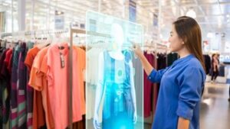
TECHNICAL BLOGS
A LEAP INTO THE FUTURE WITH METAVERSE
While one might continue to work from home, they will operate in a 3D environment that will mirror an office setting, effectively letting one live in two worlds. In one clean swoop, two objectives will be achieved: one will be able to enjoy the comforts of working from home while simultaneously being in an office space.
The Metaverse will also weed out hundreds of practical problems that remote working has created. For instance, a long trail of delayed emails can become a short problem-solving chat with an office colleague or senior in the Metaverse.
The malls of tomorrow
With the speed at which the Metaverse is developing, it is quite likely that our virtual marketplaces will be powered by 3D technology in a few years. One would be able to enter an e-shopping mall, purchase a virtual item, and will
be able to sell it as well in the same ecosystem. Not bound by the physical world’s limits, the malls in the Metaverse are likely to feature limitless designs to augment the experiences of the customers. They would be able to interact with digital products like never before, and given the growing adoption of NFTs, this is not a fad.
Attending public events
In April 2020, more than 12 million people turned up in a Metaverse created by the company Epic Games to witness singer Travis Scott’s virtual performance. In the future, such large gatherings of people, be it for a music concert, a theatrical play, or a stand-up gig, will become all the more frequent. Currently, many Metaverse ecosystems have spaces where people from all kinds of backgrounds can simply

Slide 7
TECHNICAL BLOGS
A LEAP INTO THE FUTURE WITH METAVERSE
relax, network, and socialize with each other. Truly, a world within our world.
By when will Metaverse become commonplace?
The answer to this question relies on several variables. Many digital companies suggest that Meta-worlds still have about a decade before they become genuinely mass-based.
Another variable determining how soon the Meta phenomenon becomes commonplace is the availability of cheap accessories required to log into the space. Virtual reality headsets are still quite expensive. However, the headsets and other accessories will become far more affordable in due course, paving the way for a smoother transition.
Conclusion
These are only a few ways Metaverse can affect our everyday lives. But as that day nears when the Metaverse becomes as much a reality as the Internet today is, we shall witness far more immersive and valuable Meta-experiences. Till then, Rucha Yantra shall keep you updated about the developments.

Slide 8
SPECIAL PROJECTS, EVENTS & AUDITS
NATIONAL SAFETY WEEK CELEBRATION
We would like to appreciate the enthusiasm expressed by all of you through participating in the various activities and competitions during National Safety Week from 4th March to 11th March 2022. During the safety week we all learned many new ways of safety at work, safety at home and safety at road and recommitted ourselves to integrate the learnings in our day to day behavior.
We received many safety improvement suggestions as well as competition participations from you which express human safety in various ways. While assessing the participant’s posters, essay and Poem/Slogan, we are amazed with the talent you all have in you and we must say it is very difficult to finalize winners out of the work all participants did.
We have the plant level winners already declared at plant and from the plant level winners now we have group level winners and runners-up (Best of the Best) in each competition category as follows:
Sr. No. | Name of Competition | Name of winners | Plant
1 | Poster presentation on Safety | Mr. Pradip kendre – Winner | I
 |  | Ms. Pooja Satkar – Runner-Up | V
2 | Slogan/Poem writing on Safety | Mr. Pralhad Umare – Winner | VII
 |  | Ms. Suvarna Ambuse – Runner-Up | VI
3 | Essay Writing on Safety | Mr. Hariharaputran – Winner | IX
 |  | Mr. Ashok Ubale – Runner-Up | VII

Slide 9
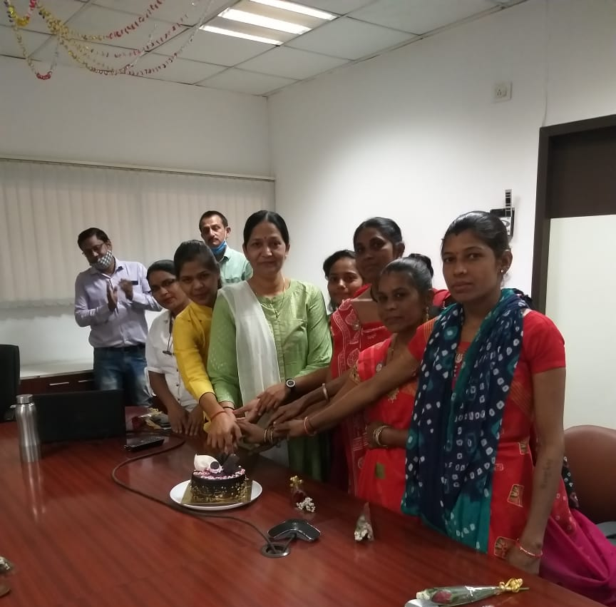
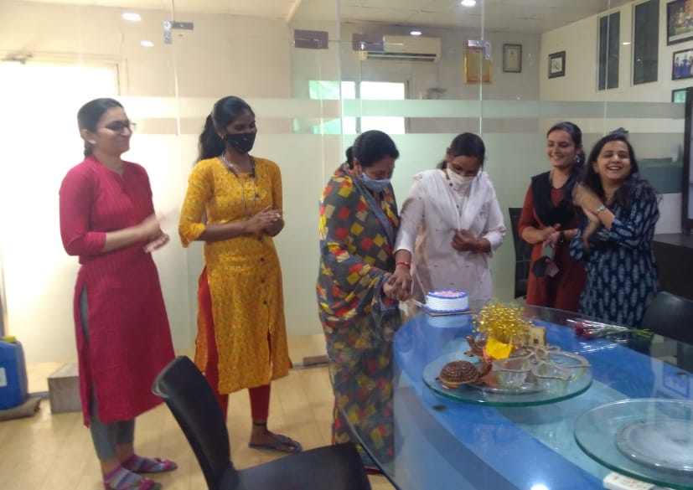
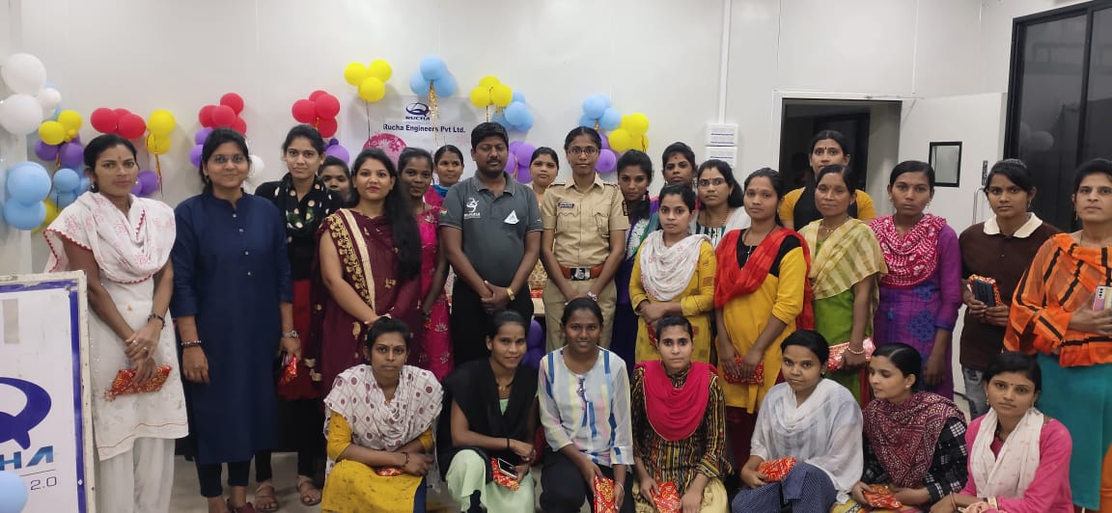
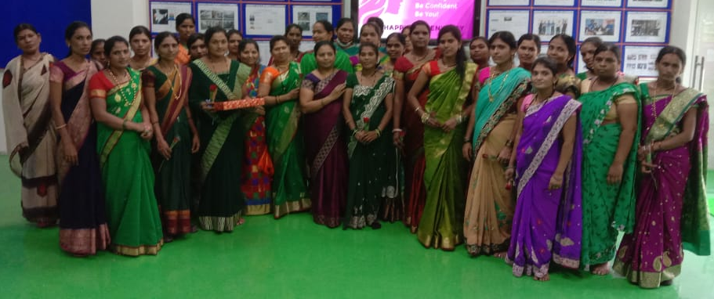
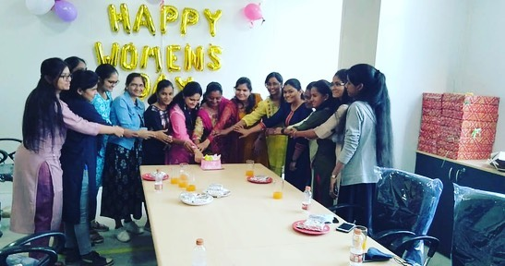
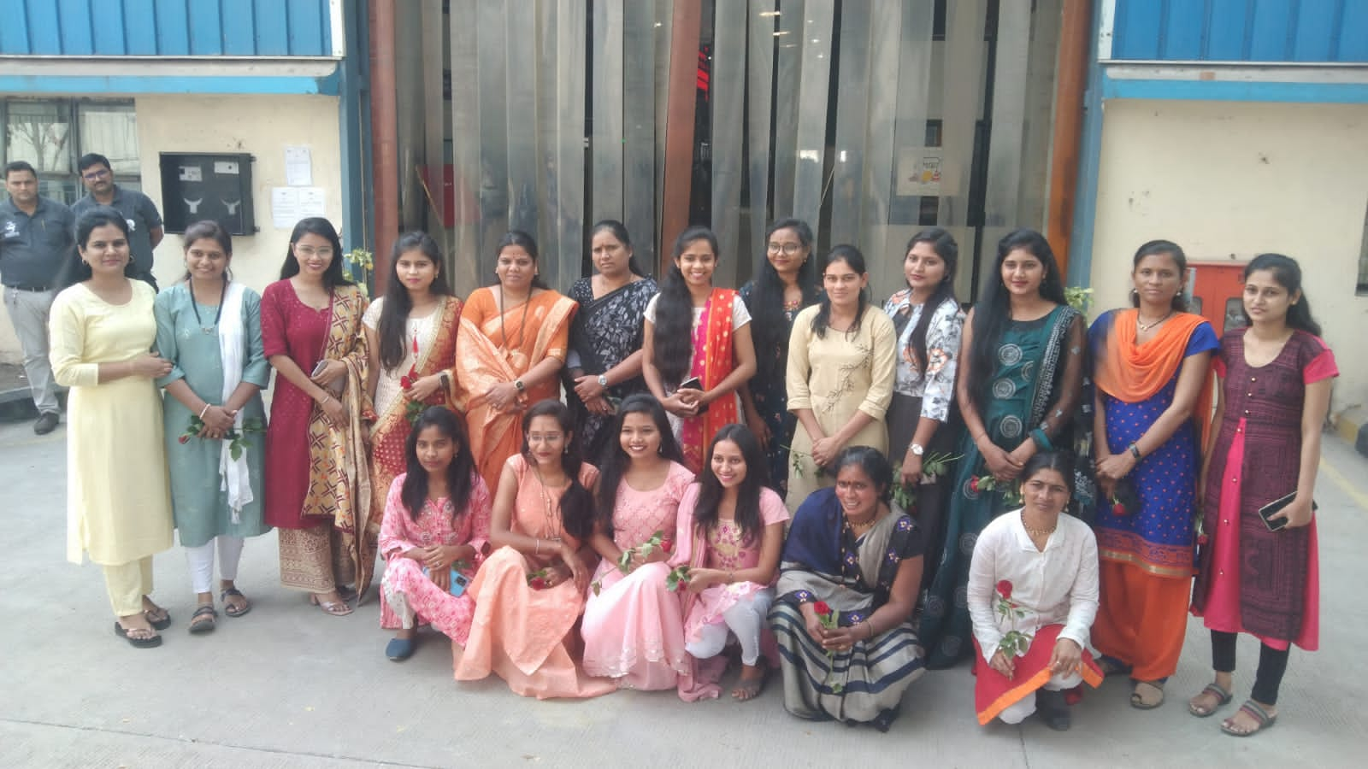
SPECIAL PROJECTS, EVENTS & AUDITS
WOMAN’s DAY CELEBRATION
International Women's Day (IWD) is celebrated on the 8th of March every year. International Women’s Day is dedicated to celebrating women’s achievements in the social, economic, cultural, and political spheres. The day, collectively founded by women, also brings attention to gender parity and women's rights.
Every year we celebrate Women’s day by arranging variety of events & programs like; workplace safety awareness, educational programs, greetings ladies staff with flowers, sessions on women's health, game events & celebrating the special day with cake cutting as well. 'Our Director and Head of Rucha Vishakha Committee Dr. Jyoti Dashrathi Madam' has shared a cheerful & encouraging message for all the women staff members on this occasion.
“A big thank you to all ladies staff members for your valuable contribution”

Slide 10
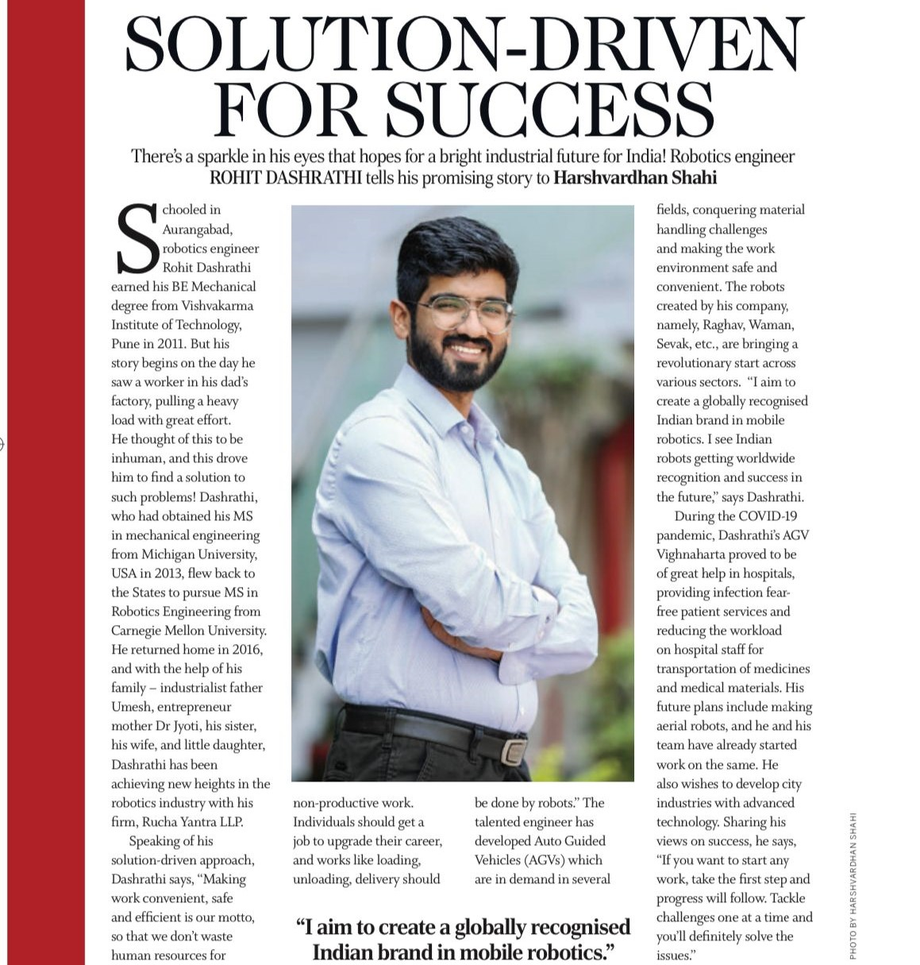
SPECIAL PROJECTS, EVENTS & AUDITS
RUCHA YANTRA
“I aim to create a globally recognized Indian brand in mobile robotics.” – said Mr. Rohit Dashrathi in conversation with Harshwardhan Sahi for Femina Media Aurangabad.
Congratulations to Rohit Sir and entire team of Rucha Yantra on this most deserving feature! Many more to follow.

Slide 11
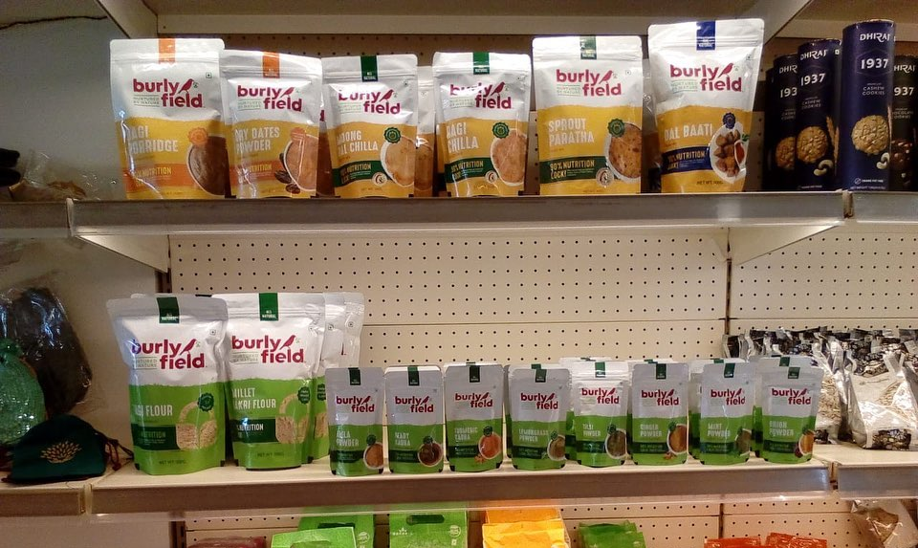
SPECIAL PROJECTS, EVENTS & AUDITS
All Burlyfield natural and healthy products are now present on India’s leading online stores – “FLIPKART” “AMAZON” AND “BIGBASKET”. Just click on the link below to explore and order.
https://www.flipkart.com/search?q=burlyfield%20in%20food&otracker=search&otracker1=search&marketplace=FLIPKART&as-show=on&as=off
Don’t forget to tell this happy news to your friends and family all over India.
Good News!!!!
We are now available at Rayate dry fruits Aurangabad a chic store with amazing healthy products. Have you checked out this store yet? If not, hurry, visit now!

Slide 12
KNOWLEDGE SHARING
POPULAR BOOKS AVAILABLE AT OUR LIBRARY...!! SUGGESTED TO READ
Mr. Arya Roy is an author with the motivation, he wrote this book and reading this book you will really going to experience new breakthrough which you don’t experience before . Every story of this book will inspire you to take stride, sustain you in times of challenge and failure. It’ll also helps you to pursue your most desired dream with more conviction and, as much as you reach the depth of this book, you’ll find yourself as a new one.
Then Finishing every story, think…..
Think whom it can inspire. Then to share the story
With them Because, the most valuable things we can do to heal one another is listen to each others, stories and , as much as, you share these stories with others, you’ll see your confidence, your hope find a new dimension.
Happy reading……!! Explore many such worthy books of your choice through our Library Management System, available on Rucha portal.
https://www.rucha.co.in/portal/index.php/LMS/LMS_cntr/user_DashBoard

Slide 13
MOTIVATION & PERSONALITY DEVELOPMENT
MOTIVATIONAL STORY : A POUND OF BUTTER
There was a farmer who sold a pound of butter to a baker. One day the baker decided to weigh the butter to see if he was getting the right amount, which he wasn’t. Angry about this, he took the farmer to court.
The judge asked the farmer if he was using any measure to weight the butter. The farmer replied, “Honor, I am primitive. I don’t have a proper measure, but I do have a scale.”
The judge asked, “Then how do you weigh the butter?”
The farmer replied;
“Your Honor, long before the baker started buying butter from me, I have been buying a pound loaf of bread from him. Every day when the baker brings the bread, I put it on the scale and give him the same weight in butter. If anyone is to be blamed, it is the baker.”
Moral : In life, you get what you give. Don’t try and cheat others.

