Slide 1
April 2023 Issue # 43

Slide 2
CONTENTS
AWARDS, APPRECIATIONS & FELICITATIONS
TECHNICAL BLOGS
SPECIAL PROJECTS, EVENTS & AUDITS
EMPLOYEE ENGAGEMENT & CSR
MOTIVATION & PERSONALITY DEVELOPMENT
BOOK REVIEW

Slide 3
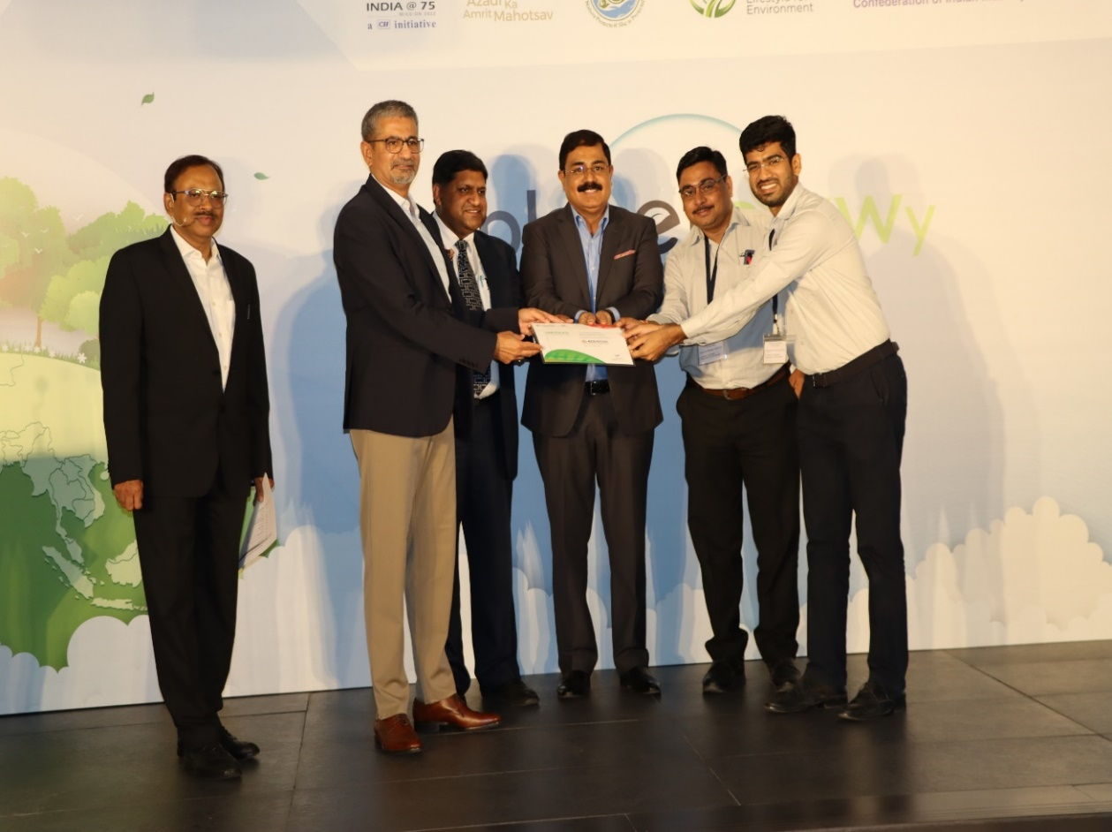
AWARDS, APPRECIATIONS & FELICITATIONS
APPRECIATION FROM ECO EDGE FOR SUSTAINABILITY DEVELOPEMNT
Rucha Engineers Pvt. Ltd. is proud to have been recognized with the ECO EDGE Certificate for the year 2022-2023. This certificate was awarded in recognition of our commitment and contribution towards integrating sustainability into our company's value chains. We are honored to have received this certificate, which was presented to Mr. Rohit Dashrathi (JMD) and Mr. Vijay Badhe (Business Head Division II).
This recognition is a testament to our dedication to sustainability and our commitment to making a positive impact on the environment. We are proud of this achievement and look forward in continuing our efforts in the years to come.
Together, we can make a difference and create a greener future for all.

Slide 4
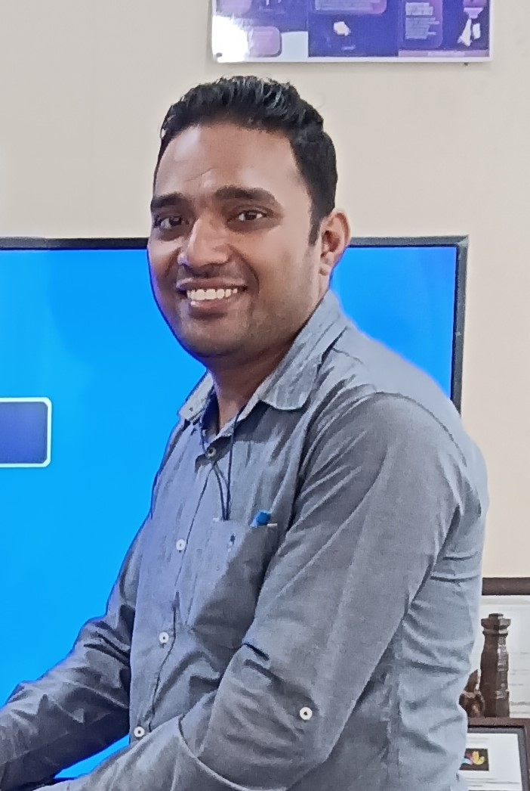
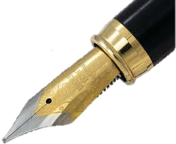
AWARDS, APPRECIATIONS & FELICITATIONS
HEARTIEST CONGRATULATION MR. ABHISHEKH LAMBE !!
We are delighted to congratulate Mr. Abhishek Lambe for successfully completing the VDA 6.3 Process auditor training that was conducted from 20th March to 25th March 2023. This training was conducted by TUV SUD and Mr. Lambe has shown exemplary dedication and commitment towards the training. His hard work and determination have enabled him to complete the training successfully and we are proud of his achievement. We wish him all the best for his future endeavors.
Once again, congratulations on this outstanding achievement.
“Live as if you were to die tomorrow. Learn as if you were to live forever.” ― Mahatma Gandhi

Slide 5
TECHNICAL BLOGS
BIG DATA, BIG BENEFITS: HOW IT’S TURNING CONVENTIONAL FACTORIES INTO DATA-DRIVEN MEGA FACTORIES
“If Big Data is the new crude oil, the manufacturing industry is the furnace!” – This statement holds its weight as active sources continue to generate an explosion of data while companies seek ways to harness this information to gain insights and optimize operations and drive growth. To dive deeper into this transformative innovation, read our previous blog on Revolutionizing Manufacturing, which comprehensively explores its impact on the manufacturing industry. Now, let’s turn attention to why exactly manufacturers need Big Data.
To Employ a Data-Driven Manufacturing, That’s Simple!
Imagine a scenario where a manufacturing company is grappling with tons of production data. They have collected this data for years, but it seems like an unsolvable puzzle. It’s frustrating, isn’t it? You might ask, “Why do manufacturing companies need Big Data? Can’t they continue with their old ways?” And the answer lies in the abundance of intelligence that manufacturing companies can derive from this data influx. As Industry 4.0 gains momentum, it’s no secret that manufacturing has come a long way from the days of Henry Ford’s assembly line.

Slide 6
TECHNICAL BLOGS
While automation, robotics, and artificial intelligence have made factories more efficient, they generate a colossal amount of data that can overwhelm manufacturing companies. But according to McKinsey, just 1% of this data is analyzed for decision-making, leaving 99% wasted. Remember the paradigm of General Electric? Through rigorous analysis of data sourced from sensors and other pertinent channels, GE has optimized its performance across its array of products – from aircraft engines to turbines. But what aspects did they prioritize?
Critical Benefits of Auctioning Big Data into Manufacturing
1. Enabling Real-time Monitoring: The increased demand for lean production and just-in-time manufacturing has already emphasized real-time monitoring on factory floors. Reports by Frost & Sullivan estimate that real-time monitoring solutions can lead to a 30% waste reduction and a 25% improvement in productivity.
2. Tailored Offering: Customization has become a critical component of business success; in fact, a study by Deloitte suggests that 36% of consumers expressed an interest in personalized products. For instance, an analysis of customer data can reveal which customer segments most value features or attributes.
3. Ensuring Workplace Safety: Manufacturers that use data-driven approaches to workplace safety are 70% more likely to achieve their safety goals. With Big Data analytics, manufacturers can identify patterns that may contribute to risks – from identifying hazards on the production line to monitoring worker behaviors.
4. Sustainable Manufacturing: As the world becomes more conscious of its carbon footprint, manufacturers are turning towards sustainable practices to optimize their supply chain and reduce emissions and energy consumption. Not to mention leaning towards renewable energy sources to enable sustainable operation.

Slide 7
TECHNICAL BLOGS
5. Informed Decision-Making:
Manufacturing executives believe that Big Data analytics will improve how they make decisions, with potential benefits such as a 5-6% increase in productivity and a 10-20% reduction in costs. Additionally, allowing them to remain agile and responsive in the evolving manufacturing industry.
But How Can Big Analytics Benefit SME Manufacturers?
Now, you might be thinking, “But isn’t big data expensive and complicated to implement?” And you are not wrong! While it’s true that implementing a Big Data strategy requires a significant investment in infrastructure and talent, the benefits far outweigh the costs in the long run. In fact, a study by Accenture found that companies that invest in big data and analytics outperform their peers by up to 20% in terms of profitability. But how can SMEs capitalize on this investment infrastructure while proactively tackling operational obstacles? That’s a topic for our next blog.
As we provide a guideline on how to adopt big data in your manufacturing setup, stay tuned to Rucha Yantra’s Knowledge Corner. Also, we would love to hear suggestions from you – our loyal audience – on the topic for our next blog series. The next series starts at the end of May, so keep your suggestions coming to our LinkedIn page.

Slide 8
SPECIAL PROJECT, EVENT & AUDITS
RUCHA YANTRA’S 1ST DRONE PROJECT TESTED
SUCCESSFULLY !
Team Rucha Yantra Delivers drones are UAVs used to transport packages/loads across locations.
The most widely tested type of drone delivery is for medical and healthcare supplies, which has been tested in many progressive countries.
In a similar attempt we at Rucha Yantra have undertaken this project of our first ever drone - VIRAAT which has a capacity of 40 Kg.
Sharing the link of video of its trial run with you all.
https://youtu.be/TNFVgyrPeo0

Slide 9
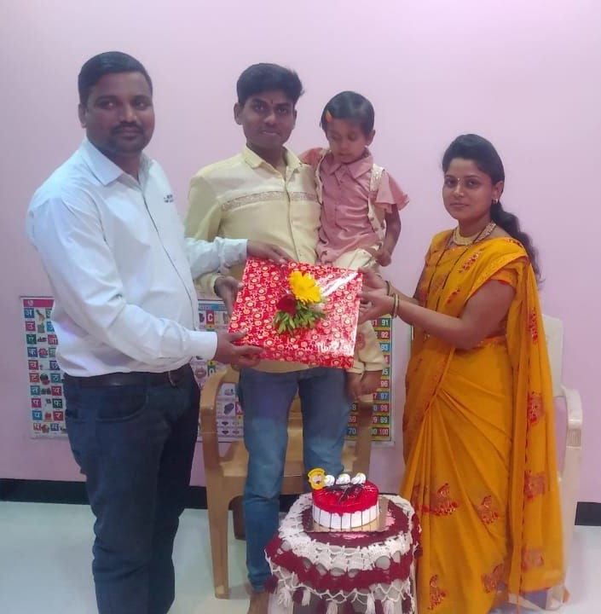
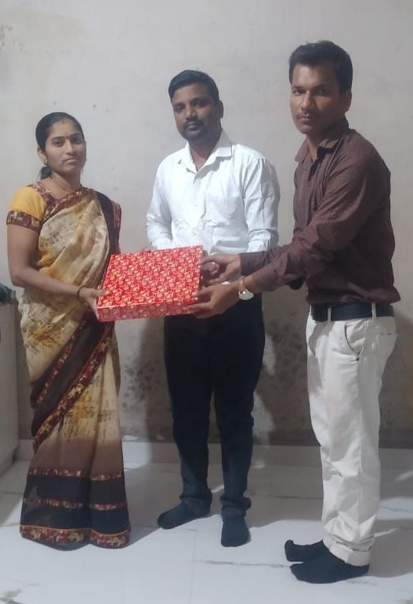
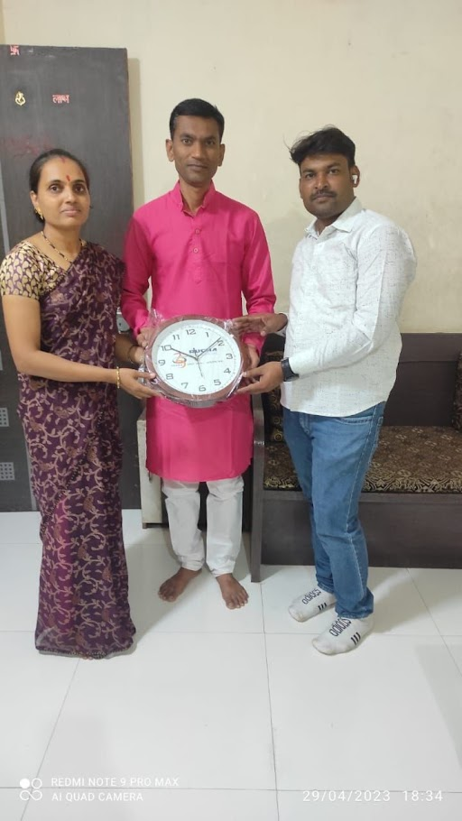
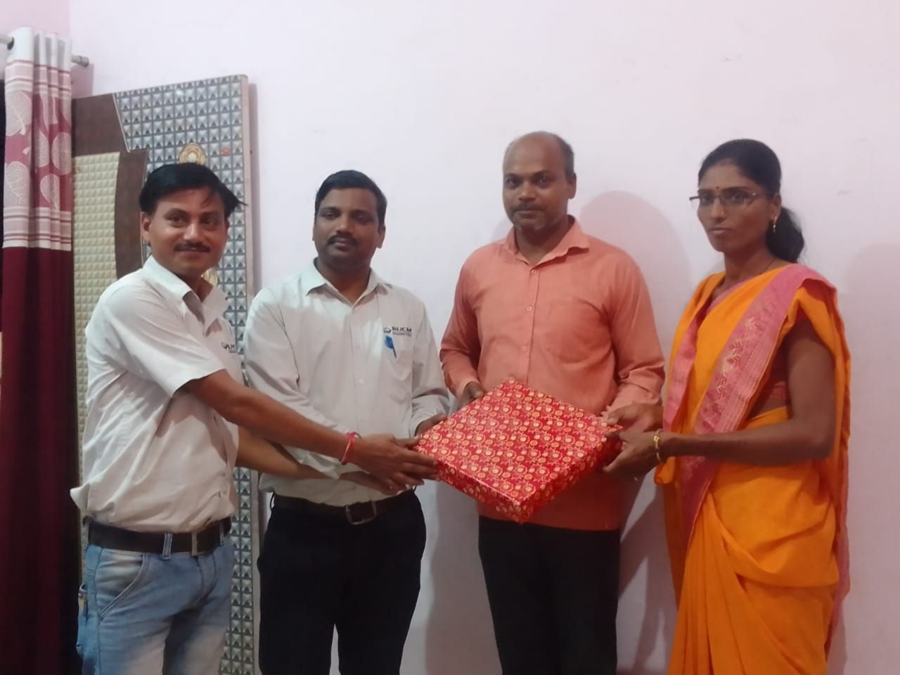
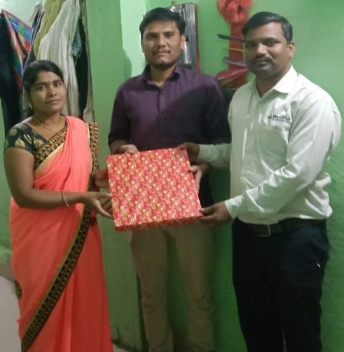
SPECIAL PROJECT, EVENT & AUDITS
SPECIAL PROJECT, EVENT & AUDITS
HR AAPLYA DARI
REPL Group is always taking necessary initiatives to contribute to the happiness of its employees.
One of them is HR Aaplya Dari (HR at your door). Under this initiative HR of each plant doubles the happiness of the employees by visiting their home on their Marriage Anniversary. Here are some highlights from this month
HR of Plant 3 & plant 4 Mr. Umesh Jogi and Mr. Sachin Nikam celebrated the Anniversary of our employee.
With a team member like you, it becomes easier for the company to achieve goals.
Happy Anniversary.

Slide 10
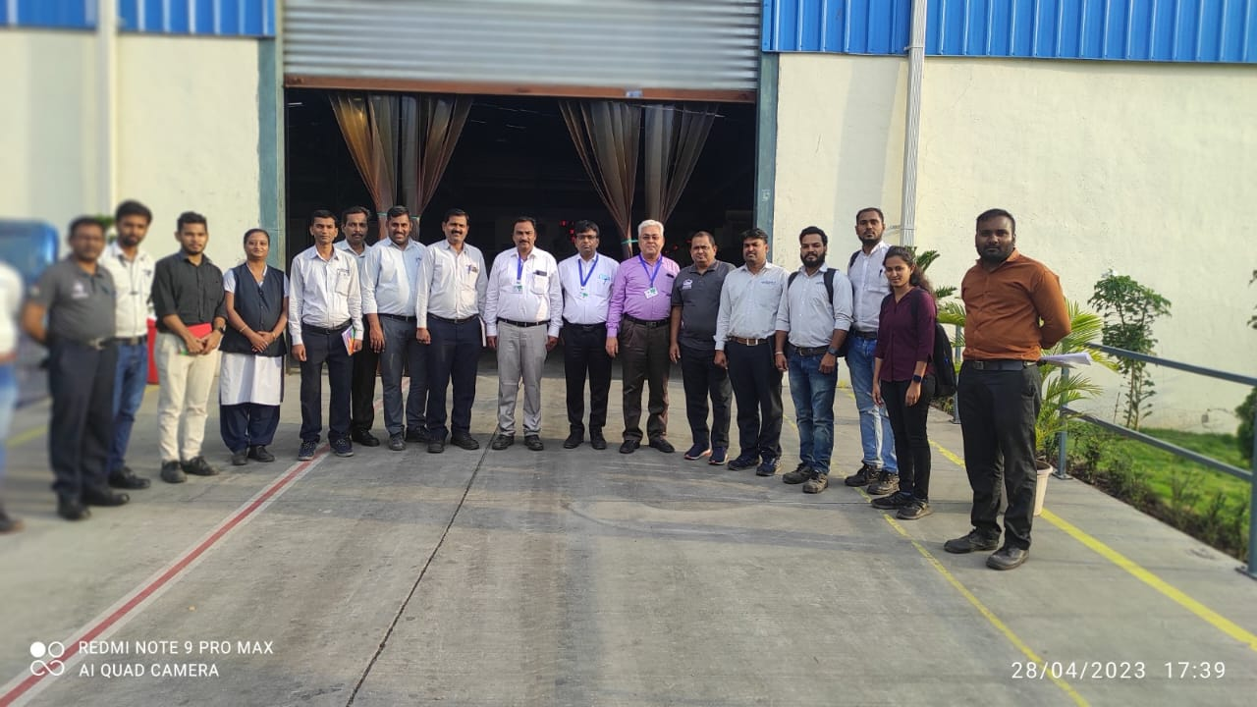
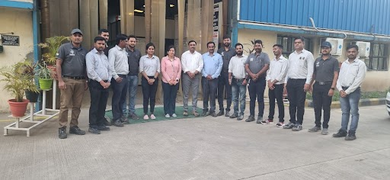
SPECIAL PROJECT, EVENT & AUDITS
EMS & OHSAS SURVELLENCE AUDIT PLANT IV & PLANT V
This is a great achievement for our organization, and it is a result of hard work and dedication of our team. ISO 14001:2015 and ISO 45001:2018 certification is a globally recognized standard for environmental management and occupational health and safety management systems. It helps organizations to identify, control and reduce the environmental impact of their activities, products and services. It also helps organizations to identify, control and reduce the risks associated with occupational health and safety. This certification will help us to demonstrate our commitment to environmental protection and occupational health and safety.
We are proud to have achieved this certification for our plant 4B & plant 5. We are committed to maintaining the highest standards of environmental management and occupational health and safety. We would like to thank Plant 4B and plant 5 team for their hard work and dedication in achieving this certification. We would also like to thank Mr Sunil Wankhede from BSI for his guidance and support throughout the audit process at both plant.
Plant 4B Team With Auditor
Plant 5 Team With Auditor

Slide 11
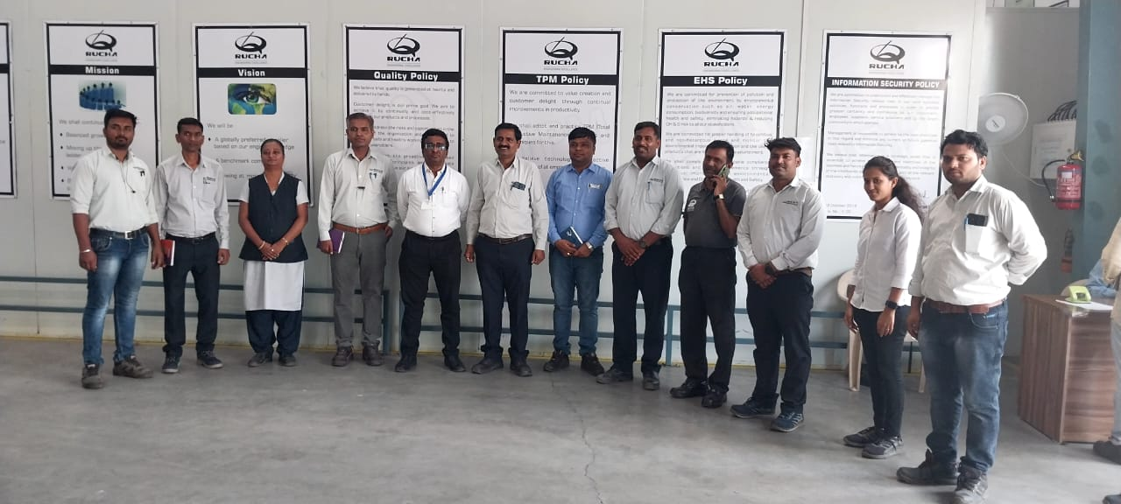
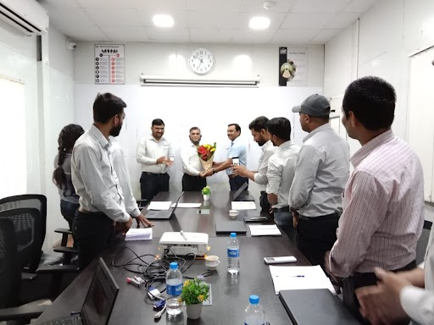
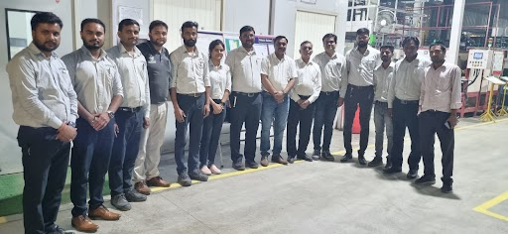
SPECIAL PROJECT, EVENT & AUDITS
IATF SURVELLENCE AUDIT PLANT 4B & PLANT 5
We, at Plant IVB & Plant V, are proud to announce that we have successfully cleared the IATF 16949:2016 certification Stage 1 Audit. This is a major milestone for us, and we would like to thank our team for their hard work and dedication in making this possible. The audit was conducted by Rajendra Patil at plant V and Mr. Pravin Saljoshi at Plant IVB from the British Standards Institution (BSI) on 25th April 2023.
We are now recommended for final certification, and we are confident that we will be able to achieve this goal as well. This certification is a testament to our commitment to quality and safety.
We are proud of our team for their efforts in making this happen and we look forward to continuing to provide our customers with the highest quality products and services.

Slide 12
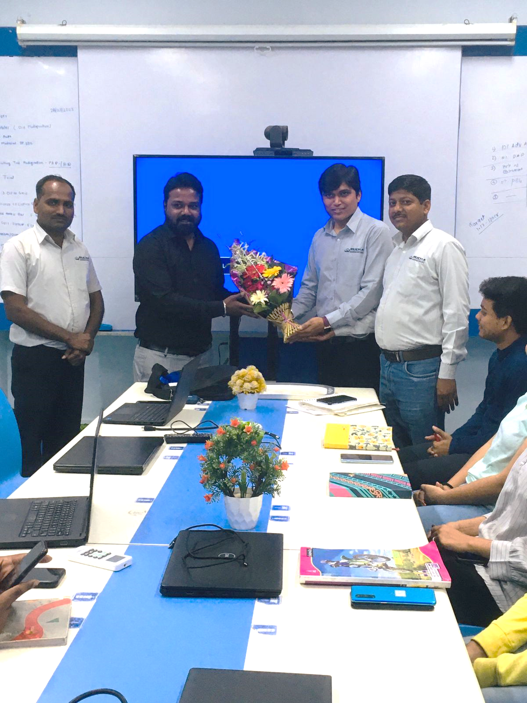
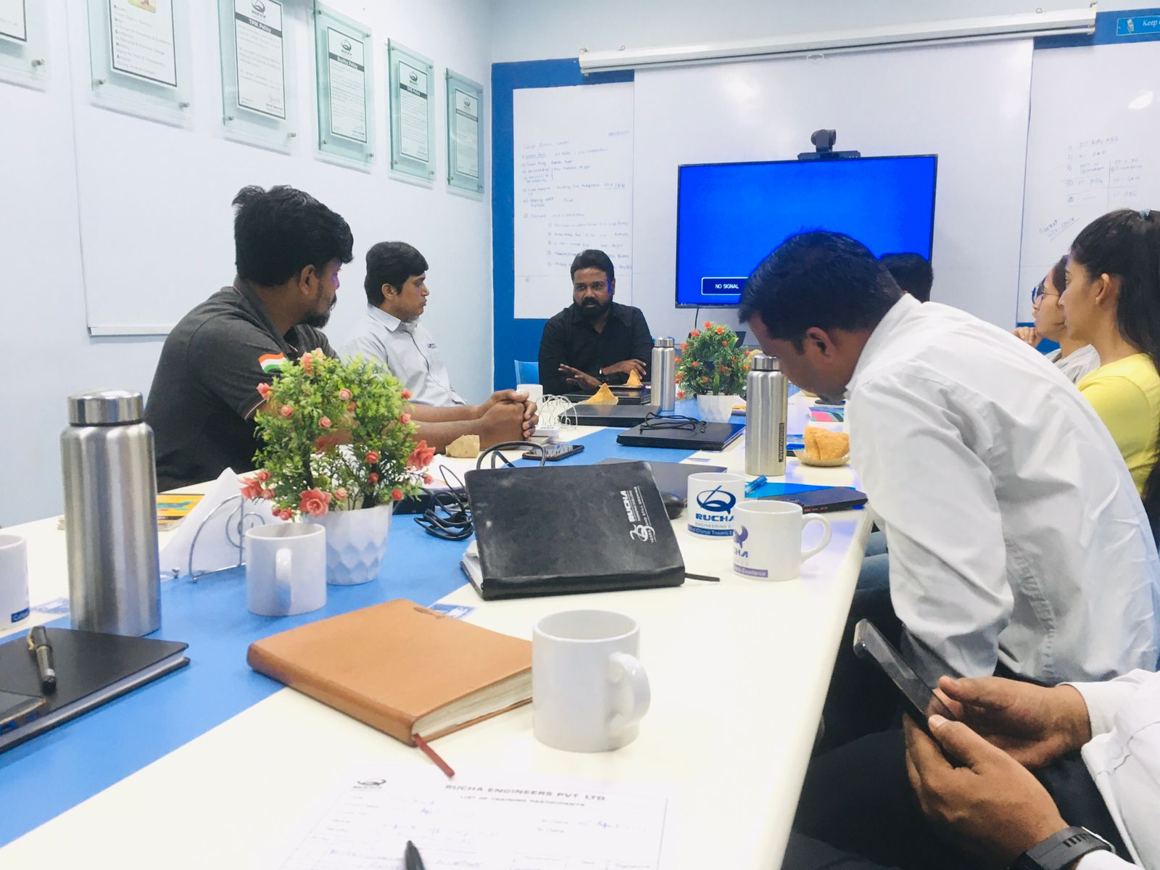
SPECIAL PROJECT, EVENT & AUDITS
KNOWLEDGE SESSION OF MR. RAVVINDRA KADAM ON RECRUITMENT
We at REPL (our organization) invited Mr. Ravvindra Kadam to share his expertise with our team. Mr. Ravvindra has12 years of experience in recruitment. The session was focused on recruitment and its related aspects. Mr. Ravvindra Kadam shared his insights on the importance of recruitment in an organization, the process of recruitment, the challenges faced during the process and how to overcome them. He also discussed about the various tools and techniques used for recruitment. A heartful thanks to Mr. Ravvindra Kadam for this informative knowledge sharing session.
The only source of knowledge is experience.“ - Albert Einstein

Slide 13
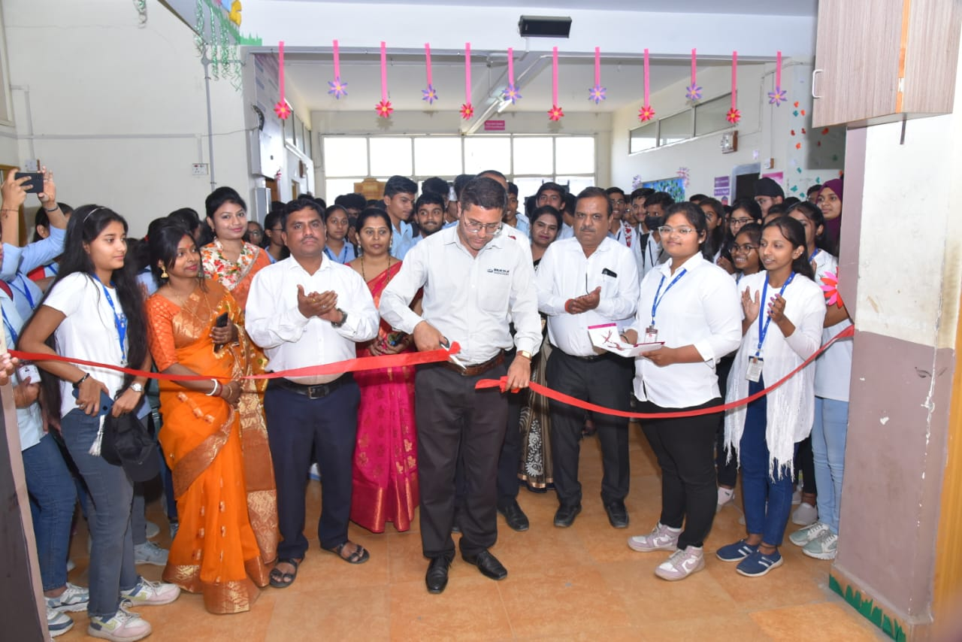
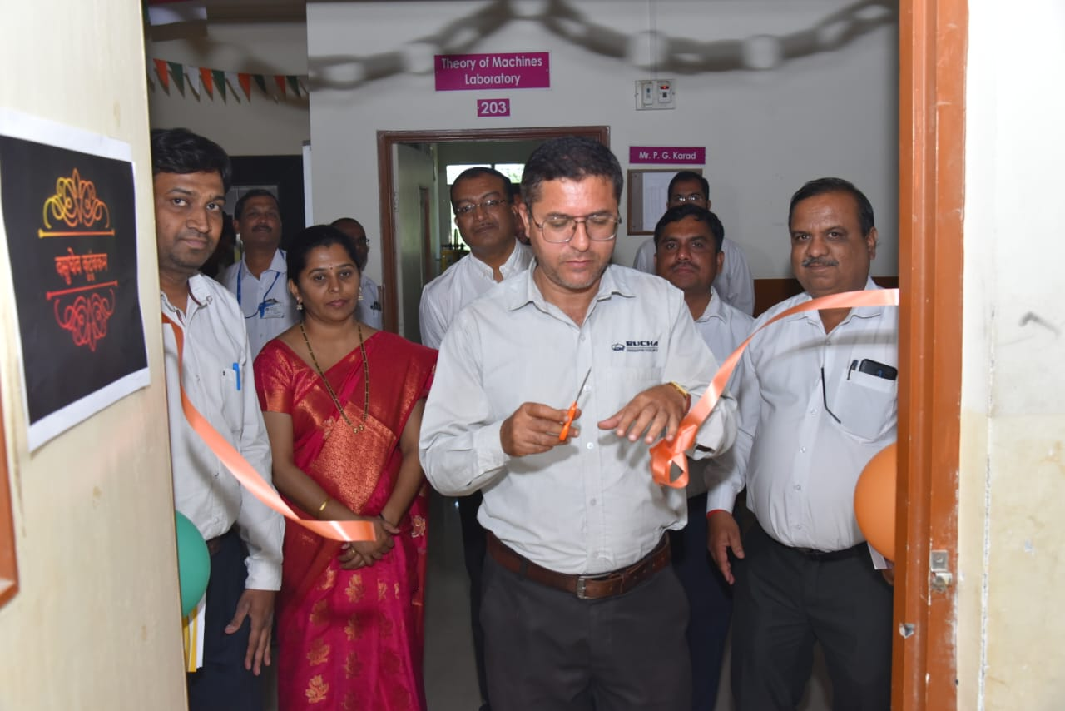
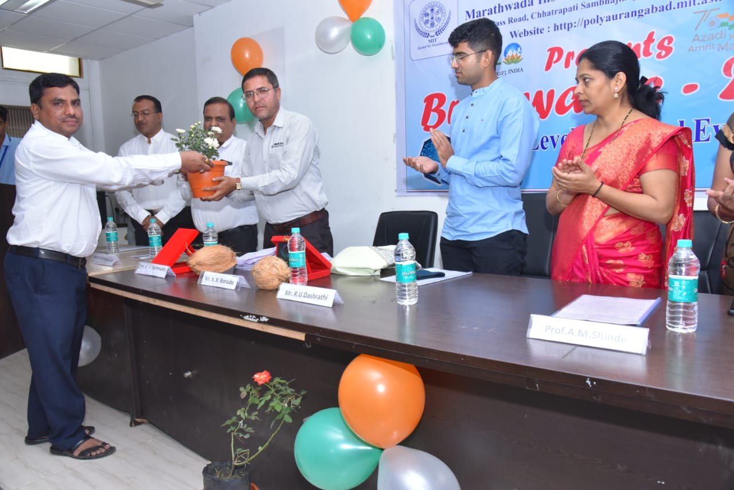
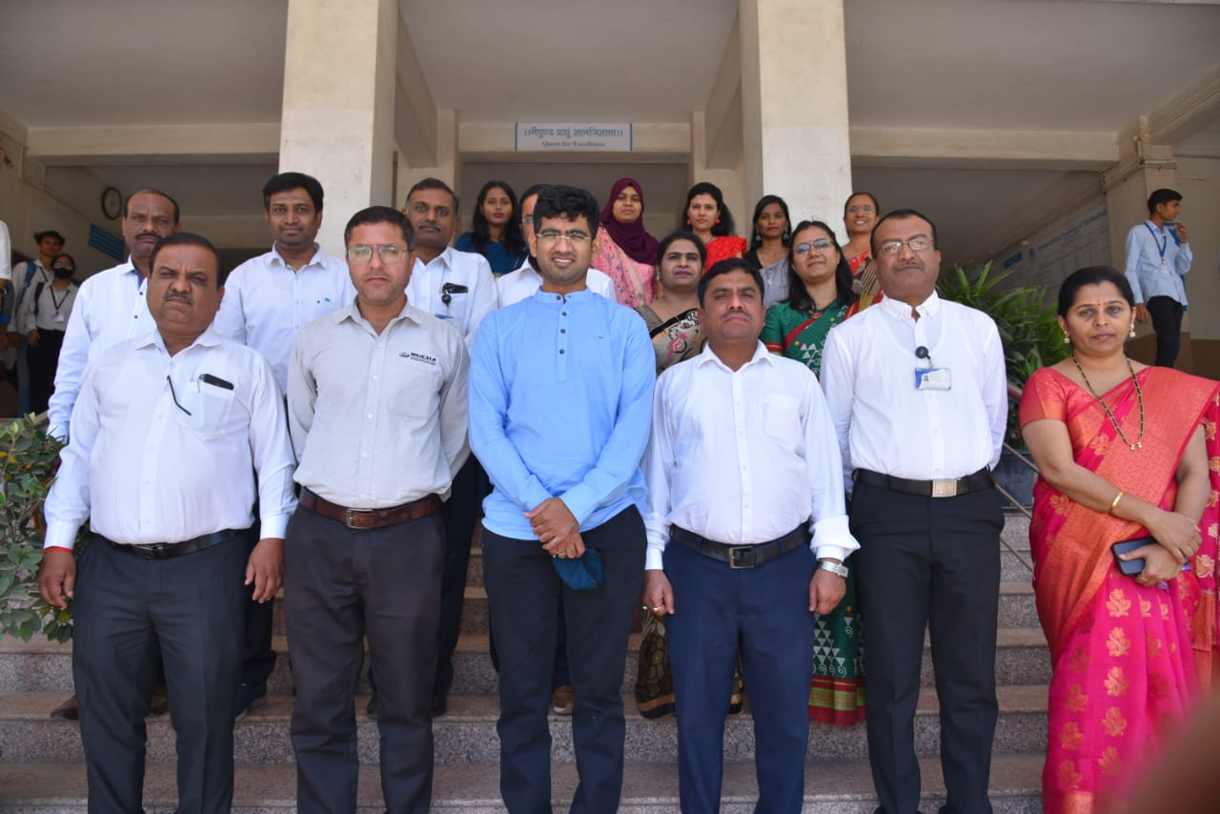
SPECIAL PROJECT, EVENT & AUDITS
REPL JMD & YANTRA DIVISION HEAD INAUGURATED THE POSTER COMPETITION AT MIT COLLEGE
A poster competition was organized by the MIT College of Engineering, on 11th Apr- 2023 for the enthusiastic and creative students of MIT College. The posters were based on the Technical Topics. Mr. Rohit Dashrathi JMD of the REPL group & Mr. Kunal Burade REPL Yantra head inaugurated the program.
The Director, Dr. Santosh Bhosale, and all staff member was present at the time of inauguration. Director sir and chief guest Mr. Rohit Dashrathi were appreciated and praised to all Participants
We are confident that their presence will be a great source of inspiration for the students and will motivate them to come up with innovative ideas. We wish them all the best for the event and hope that they have a great time.
We would like to thank the MIT college for giving us this opportunity and we are looking forward to a great event.

Slide 14
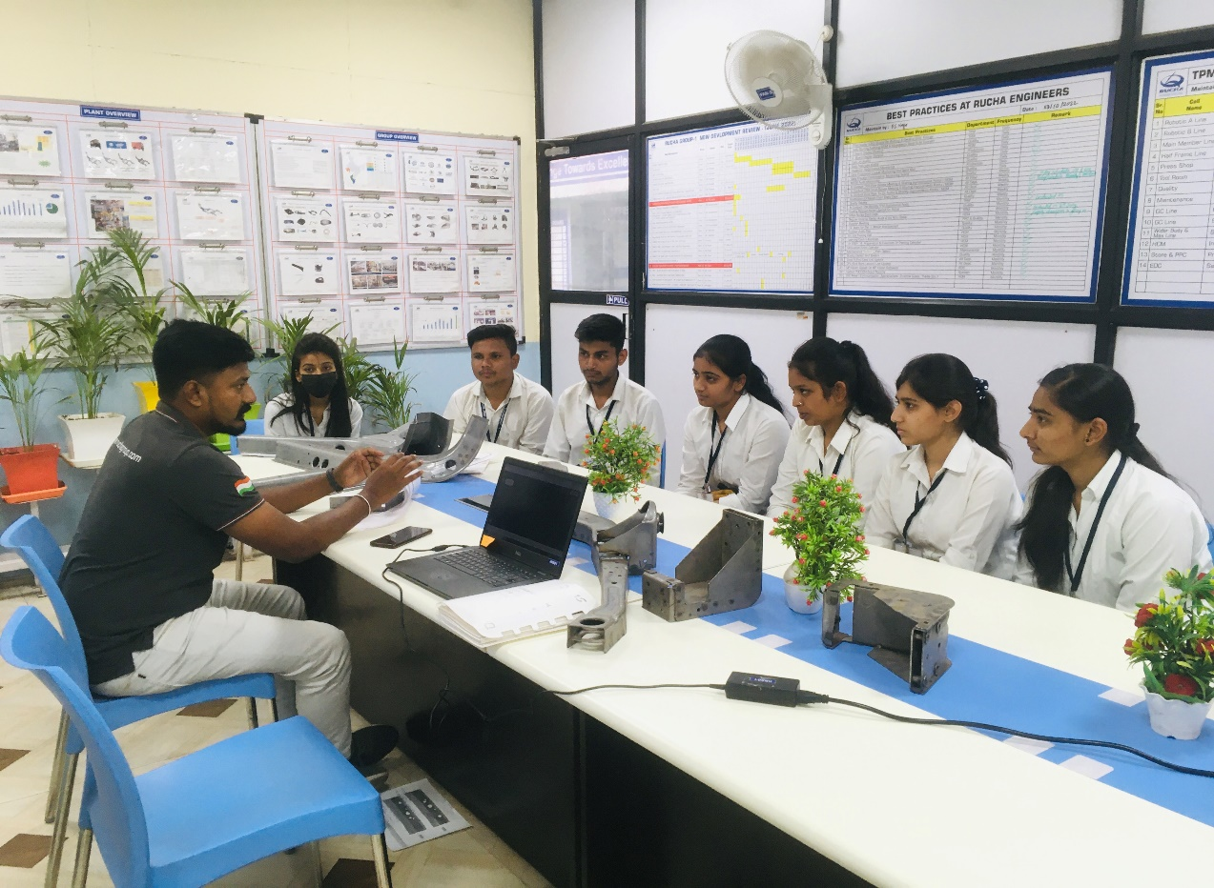
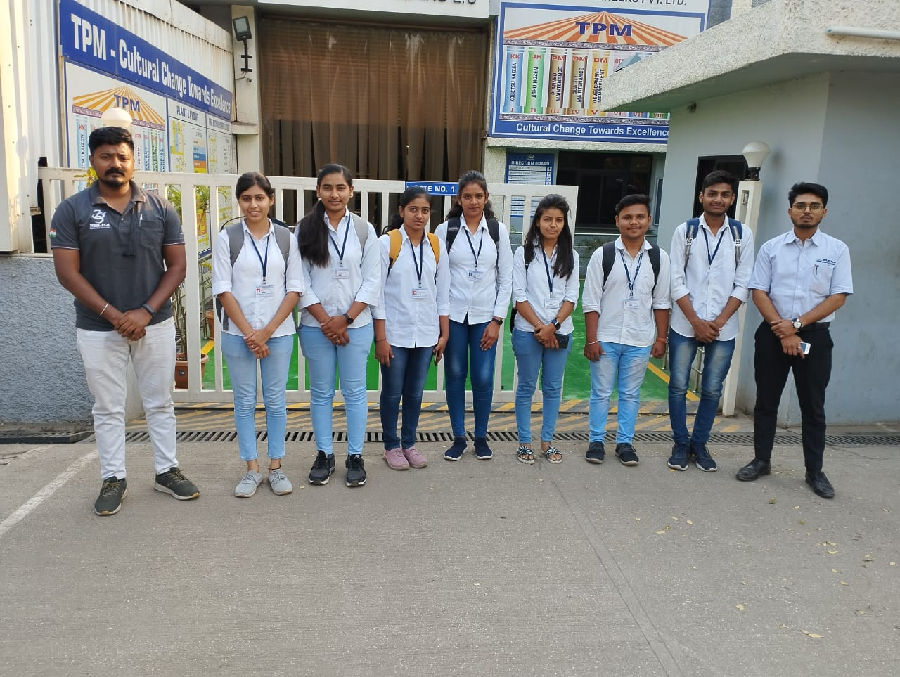
SPECIAL PROJECT, EVENT & AUDITS
COLLEGE COLLABORATION
At Rucha Group, we believe in empowering student minds and providing them with the opportunity to upgrade their knowledge and feel connected to the industry. In Apr, our plants hosted some knowledge sharing visits to college students of DIEMS, providing them with an immersive experience of the technologies, systems, manufacturing and automation processes used in our plants. Through guided tours and interactive sessions with the engineers and technicians, students were given a firsthand view of the processes and operations of our plant.
We firmly believe in the power of collaboration between young minds and industry professionals, and we are committed to welcoming and fostering such partnerships. We look forward in continuing to create learning opportunities for students and providing them with the opportunity to contribute their ideas and creativity to our work.

Slide 15
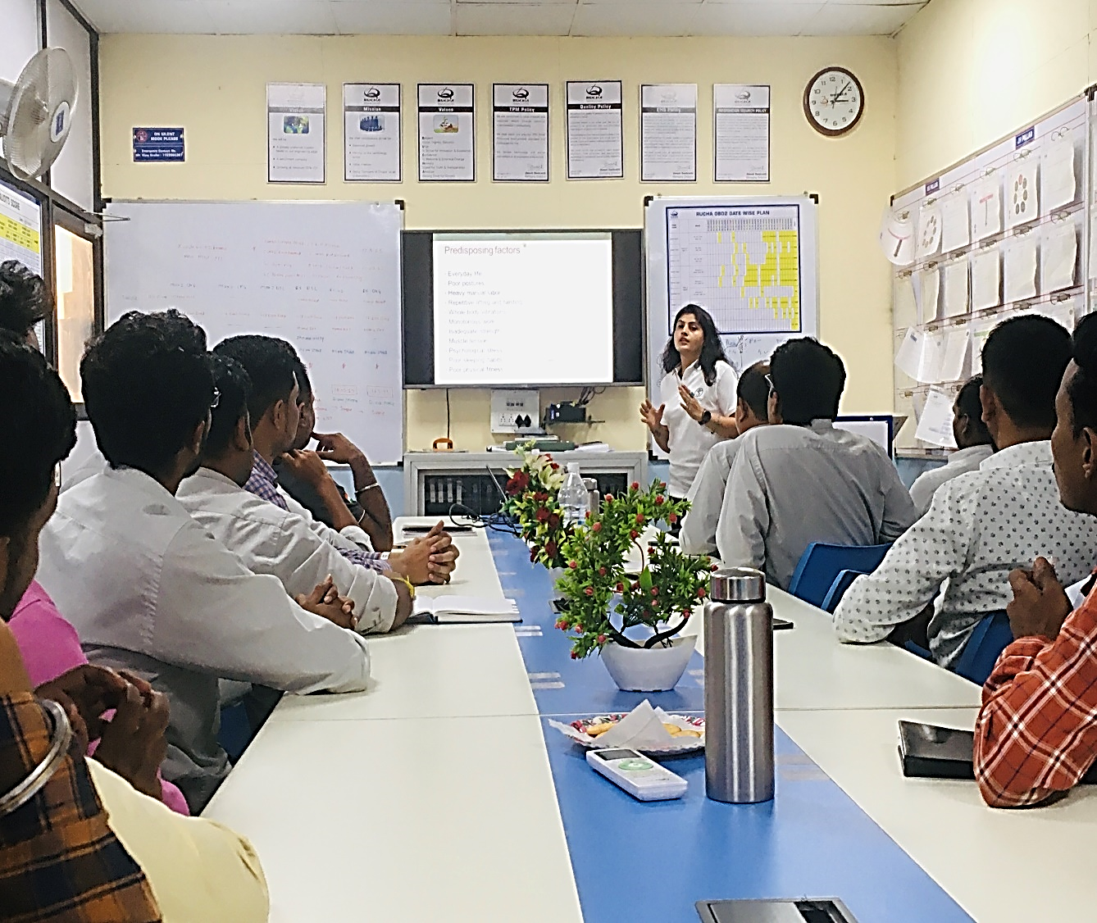
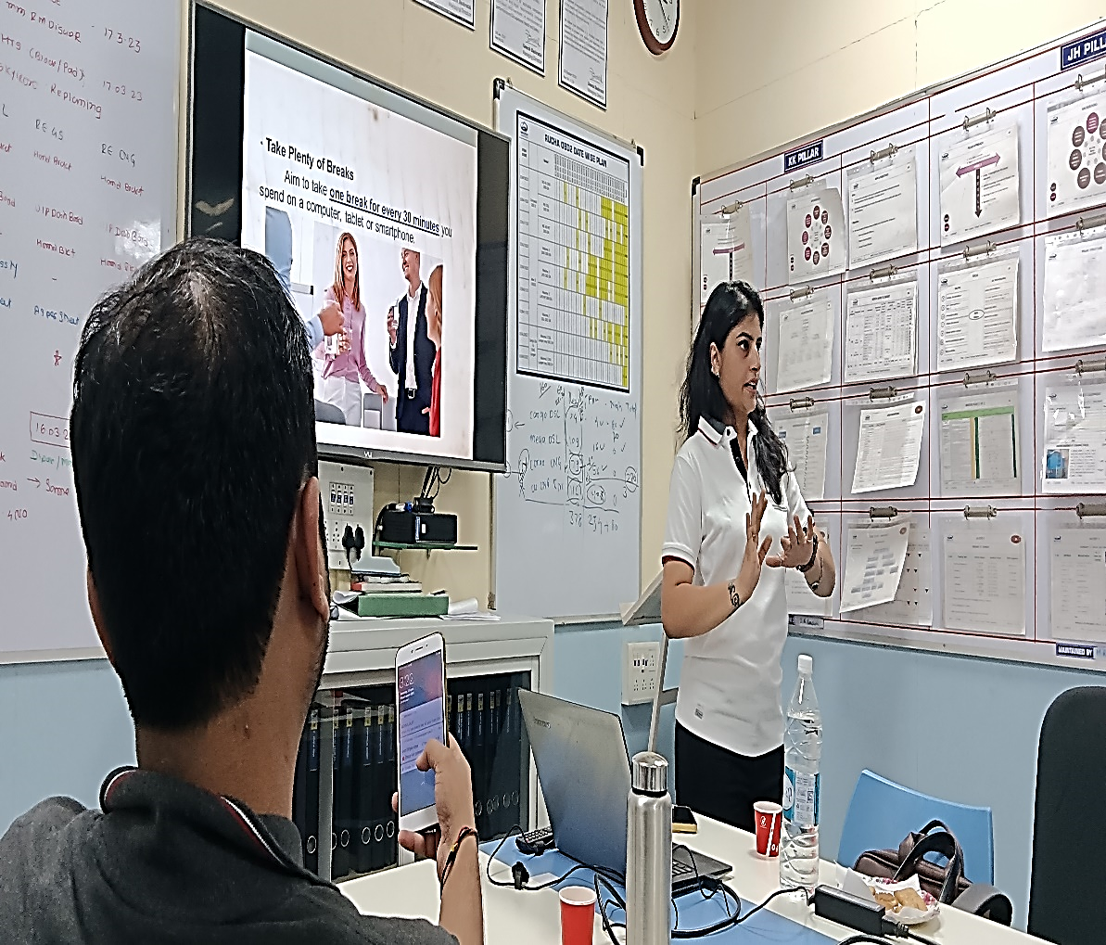
SPECIAL PROJECT, EVENT & AUDITS
HEALTH AWARENESS (NECK SYNDROME) SESSION CONDUCTED BY DR. ASHWINI JAISWAL
Employee health is an important factor in any organization. It is essential to ensure that employees are healthy and fit to perform their duties. This is why Rucha Engineers has taken the initiative to provide training on Neck Syndrome to its employees. The training provided by Dr. Ashwini Jiswal has been beneficial for the employees of Rucha Engineers. It has helped them understand the importance of taking care of their neck health and how to prevent neck pain and other related issues. The training has also helped them understand the importance of proper posture and how to maintain it.
We are committed to taking care of our employee health and providing them with the best possible health care.A heartful thanks to Dr. Ashwini Jaiswal for this informative knowledge sharing session.

Slide 16
SPECIAL PROJECT, EVENT & AUDITS
BURLYFIELD PRODUCTS NOW ON JIOMART
We are delighted to announce that all our Burlyfield products are now also available on Jiomart along with Bigbasket, Flipkart and Amazon. Now ordering your favourite summer special products is even more convenient.
https://www.jiomart.com/search/burlyfield

Slide 17
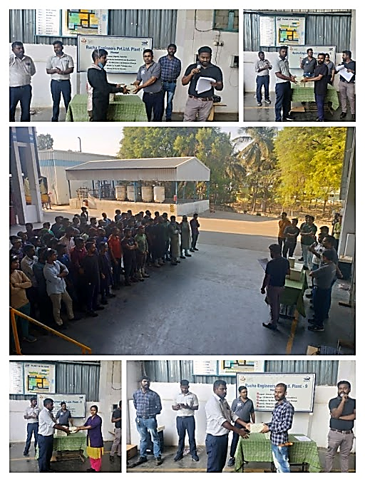
EMPLOYEE ENGAGEMENT & CSR
PLANT COMMUNICATION MEETINGS
At Rucha Group, we believe in creating an environment of open communication and collaboration, that's why we have regular PCM (Performance Communication Meeting) sessions for our employees. These sessions provide an ideal platform for our employees to report on the business environment, discuss strategy, reward improvements and address grievances.
This month, our colleagues from Hosur (Plant 9) had the privilege of being addressed by our Vice President, Plant Heads and HODs. During the session, our employees were recognized and awarded for their performance in various competitions such as:
Best Kaizen
Best Employee
Best Operator
Best Quality Inspector
Best Performer of the Month

Slide 18
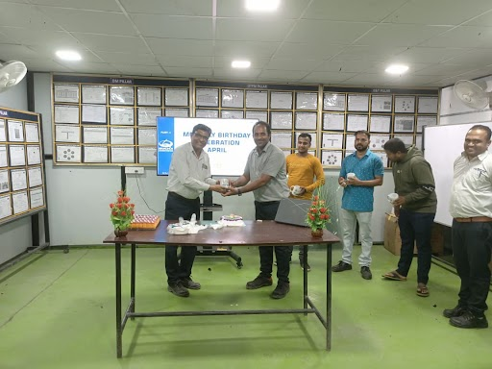
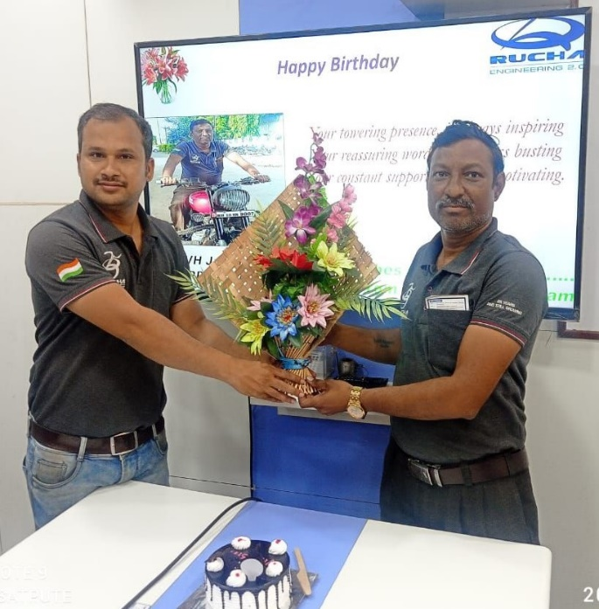
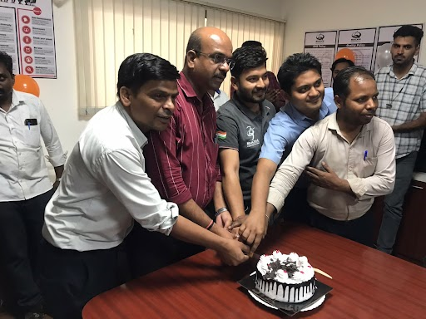
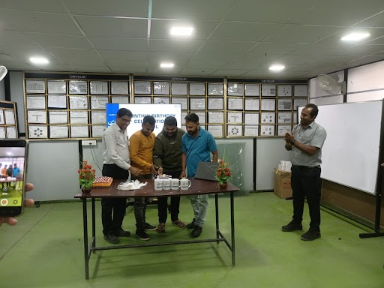
EMPLOYEE ENGAGEMENT & CSR
BIRTHDAY CELEBRATIONS
Our employees are the backbone of our company. They are the driving force behind the success of the organization. Therefore, it's essential to appreciate and recognize their efforts and hard work. Birthdays are a special occasion for everyone, and it's a great opportunity for the company to show their appreciation towards the employee. Here are the glimpses of our celebrations from various sites (Plants).

Slide 19
MOTIVATION & PERSONALITY DEVELOPMENT
MOTIVATIONAL STORY: THE STORY OF THE GRATEFUL STARFISHES (INSPIRING STORY ABOUT ATTITUDE)
One morning, an elderly man was walking along the beach when he noticed a young boy picking something off the sand and throwing it into the sea.
As he got closer, the man realized the child was throwing stranded starfishes that had washed up on the shore back into the breaking waves.
Approaching the boy, the man asked what he was doing.
“The starfish will die if they’re still on the shore when the sun rises,” he replied.
Perplexed, the old man said, “But that’s pointless! There are countless miles of beach and thousands of starfish. It doesn’t matter how many you return to the water, you can’t make a difference. ”Unfazed, the boy bent down, picked up another starfish, and tossed it into the sea.
“It matters to this one,” he said.
Moral of the story: No matter the odds of success or the scale of the challenge, your actions can make a difference. It’s better to light a candle than curse the dark. Every little counts. Doing something to make a positive change is always better than nothing!

Slide 20
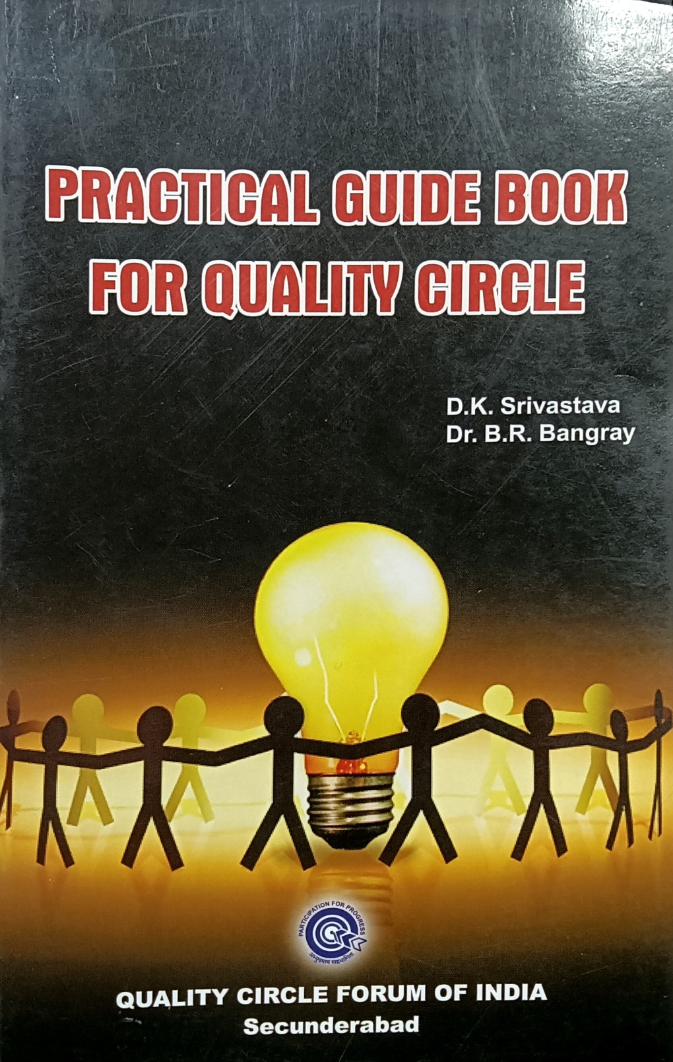
BOOK REVIEW
POPULAR BOOK AVAILABLE AT OUR LIBRARY...!!!
SUGGESTED TO READ
About a decade back it was felt that Quality Circle members needed a handbook as a ready reference while conducting the meetings. Hence a bilingual (English-Hindi) handbook was published to serve this purpose. The book found popularity amongst Quality circle fraternity. In due course of time, while conducting training Programmes and workshops on Quality Circle and problem-solving tools and techniques. feed-back received from participants was that the handbook is good to understand the theoretical concept and it will be better to have practical guidelines also. Therefore, this Practical guide book is compiled. It contains topics on Quality Circle concepts, as well as more details about statistical tools and techniques, and its appropriate use in the steps of problem solving. Elaborate explanation is given to problem solving steps with examples. Evaluation criteria is also being explained for the guidance of Quality Circle teams.
Happy reading ……!!!
Explore many such worthy books of your choice through our Library Management System on Rucha portal.

